Slide 1
Experiencia #2
Communicative Objective:
To start and maintain a basic conversation with a classmate using well formulated questions and answers through Blackboard IM.
Intro. / Warm Up

Slide 2
Experiencia #2
NOW,
We are going to see how we should talk with someone via Chat.
Transition

Slide 3
Experiencia #2
“Chatting” with a classmate.
What are the components of an appropriate introduction with a classmate?
Introduction – Write a greeting
Be nice- Include words like please and thank you.
Write an appropriate way to say goodbye.
Model
Greeting:
Hi, my name is John, and I am a university student. Do you want to chat with me? I study Spanish.
Goodbye:
Okay, I have to go. Thanks for chatting with me. Have a great day. Bye!
Pre Task Activity

Slide 4
Experiencia #2
******** ACADEMIC DISHONESTY********
*It is considered cheating and academic dishonesty to write your sentences in English and then send it through an online translator. Why? Because the whole purpose of the assignment is for you to practice communicating in Spanish.
*It is considered cheating and academic dishonesty if you have someone else do this activity for you. Why? Because the whole purpose of the assignment is for YOU to practice your Spanish communication skills.
*It is considered cheating and academic dishonesty if you open any other windows on the computer while your doing this chat. This includes looking up words in the dictionary, whether in the computer or mobile device or text book. THE ONLY WINDOW IT SHOULD BE OPENED IS THE CHAT WINDOW.
.
Activity Instructions

Slide 5
Experiencia #2
So....
For this activity, you are going to create a Blackboard account and you are going to have a conversation with a classmate.
Transition

Slide 6
Experiencia #2
BEFORE COMING TO CLASS:
Create your Blackboard IM Account via My Spanish Lab
See: Setting Up your Blackboard IM Account from your instructor
NOTE: You will not need to download the Blackboard IM platform as it has already been done in the lab where we will complete the Experiencia. These instructions are included in case you would like to use Blackboard IM at home for some other purpose.
IF YOU ARE NOT REGISTERED BEFORE THE EXPERIENCIA 5 POINTS WILL BE DEDUCTED FROM YOUR OVERALL GRADE.
Activity Instructions

Slide 7
What? Which? How? For what?
Who? When? Why? How much/many?
Using the interrogative words ask your classmate questions to find out the following information:
Number of classes they take this semester.
His/her favorite class.
Number of students in his/her favorite class.
Name of his/her favorite professor
Place where he/sje studies and how many hours he/she studies each day
Place where he works

Slide 8
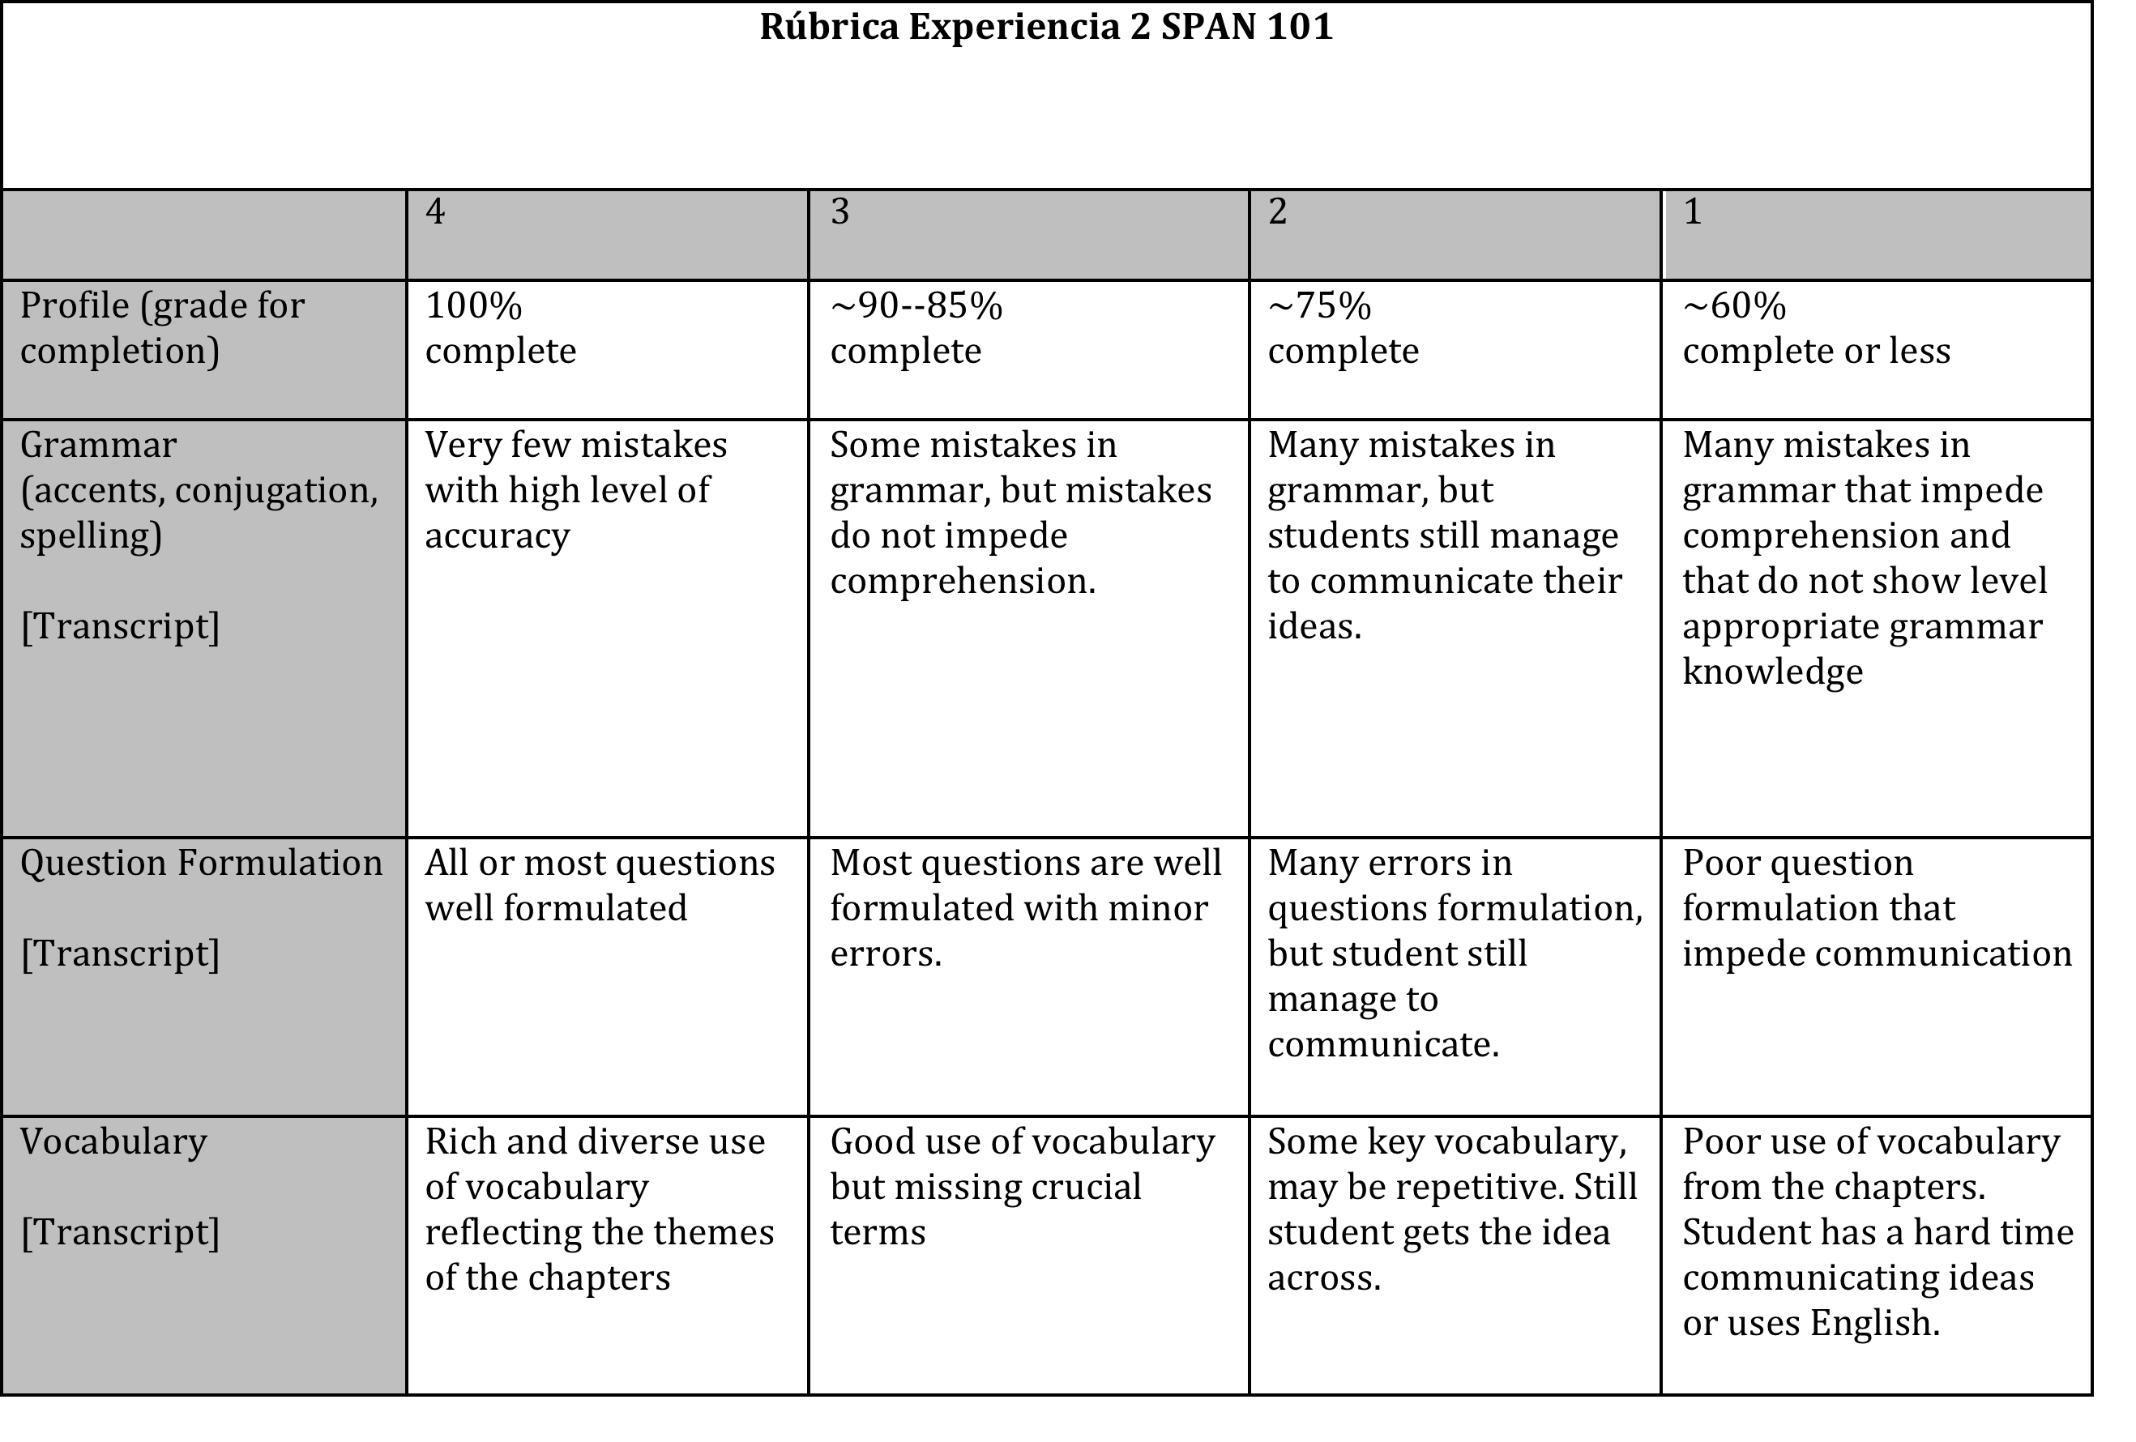
Experiencia #2
GRADING:
Activity Instructions

Slide 9
Experiencia #2
***** Questions? *****
Wrap Up

