Slide 1
Word stress

Slide 2
word think put nice
How many syllables do these words have?

Slide 3
funny copy later office
How many syllables do these words have?

Slide 4
answer castle neighbor climate
Christmas knowledge student mother
How many syllables do these words have?
Which syllable is the stress on? Which syllable do you say strongly?
What is the part of speech for these words?

Slide 5
attend collect prevent survive
explain complain remain maintain
How many syllables do these words have?
Which syllable is the stress on? Which syllable do you say strongly?
What is the part of speech for these words?

Slide 6
Where is the word stress?
For most two-syllable nouns, stress the first syllable.
CLImate, KNOWledge, etc.
For most two-syllable verbs, stress the second syllable.
to deCIDE, to reQUIRE, etc.
But of course, there are exceptions.
maCHINE, gaRAGE, etc.
to Offer, to TRAvel, to STRAIGHten, to FASten, etc.

Slide 7
fantastic academic domestic dramatic
public energetic tragic systematic
What is the part of speech for these words?
What do these words have in common?
Which syllable is the stress on? Which syllable do you say strongly?

Slide 8
fantastic academic domestic dramatic
public energetic tragic systematic
What is the part of speech for these words?
What do these words have in common?
Which syllable is the stress on? Which syllable do you say strongly?

Slide 9
station assumption completion creation
revolution description interruption collection
What is the part of speech for these words?
What do these words have in common?
Which syllable is the stress on? Which syllable do you say strongly?

Slide 10
station assumption completion creation
revolution description interruption collection
What is the part of speech for these words?
What do these words have in common?
Which syllable is the stress on? Which syllable do you say strongly?

Slide 11
For words (adjectives) that end in –ic,
For words (nouns) that end in –sion and –tion,
Stress the second-to-last syllable

Slide 12
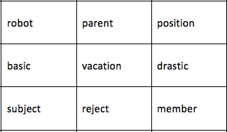
Word stress map - Find the correct path!
You CANNOT go upward

Slide 13
Word stress map - Find the correct path!
Practice
You are at “vacation”
Stress on the second syllable:_________
You are at “basic”
Stress on the second syllable & noun:_____
You CANNOT go upward

Slide 14
Word stress map - Find the correct path!
Practice
You are at “vacation”
Stress on the second syllable:_________
(Answer: reject)
You are at “basic”
Stress on the second syllable & noun:_____
(Answer: vacation)
You CANNOT go upward

Slide 15
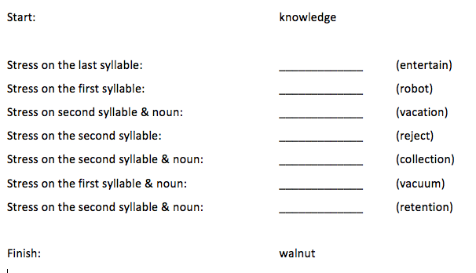
Word stress map - answers

Slide 16
What do words sound like in contexts?
He was elected to the Senate in 2008.
Cotton mittens will prevent the baby from scratching his own face.
We had a fantastic trip to Europe.
Her academic honors from home and foreign universities multiplied.

Slide 17
What do words sound like in contexts?
He was elected to the Senate in 2008.
Cotton mittens will prevent the baby from scratching his own face.
We had a fantastic trip to Europe.
Her academic honors from home and foreign universities multiplied.
Now, you know where to say strongly. But how do you say syllables that surround the strong syllable?
Do you hear the vowels underlined above (in teacher’s voice)?

Slide 18
Strong syllable & Weak syllable
A key to have good rhythm in your pronunciation is to know which syllable to say strongly, and which syllable to say weakly.
“My mama always said, Life is like a box of chocolates”
https://www.youtube.com/watch?v=CJh59vZ8ccc (play from 0:31)
Where did Tom Hanks say strongly? (4 places) Which words did he say weakly?
In English, function words (a, the, is, are, of, in, with, etc.) are often reduced.

Slide 19
different (dif-rent): You and I have different tastes.
separate (sep-rate): We are two separate people.
chocolate (choc-late): I love chocolates.
camera (cam-ra): Did you get a new camera?

